Slide 1
Mapping MITRE ATT&CK® to the PCI DSS
Notes:
Title Slide

Slide 2
Mr. Jeffrey E. Man
Information Security Evangelist
Online Business Systems
Notes:
Name, Rank, Serial Number

Slide 3



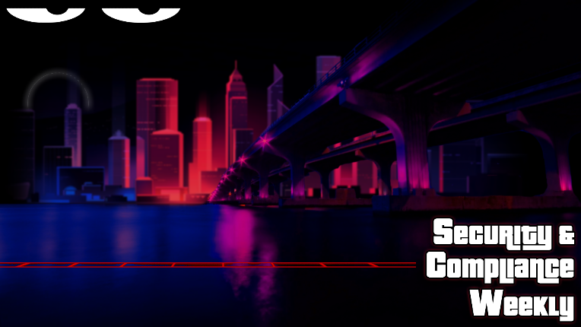
My Background
13 years with the Department of Defense
Certified Cryptanalyst
Designed Cryptosystems and Cryptologic Aids
Founding Member of Systems & Network Attack Center
10 years as a PCI Qualified Security Assessor (QSA)
Lead Assessor/Assessment Team Member
Trusted Advisor
3 years with a Software Vendor
PCI Subject Matter Expert
Thought Leader
Security Strategist
24+ years of commercial professional services
Penetration Testing
Vulnerability Assessments
Security Architecture
Trusted Advisor
Notes:
A little about me/whoami?

Slide 4

What are we talking about?
Attacks, threats, vulnerabilities, pen testing, red teaming, blue teaming, PCI, and more!
Notes:
The thesis statement, and why I decided to do this research:
I keep hearing a lot of buzz about MITRE ATT&CK and kept thinking, “why attack when you can defend?” and “I’ll bet that PCI DSS addresses all of the attack techniques detailed in the framework.”
So I set out to discover just how well ATT&CK maps to PCI DSS.

Slide 5
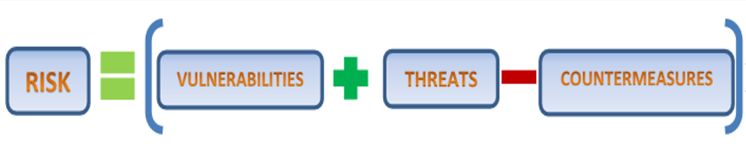
The Basic Risk Equation
Origins of our terminology
Notes:
This is how I learned about security when I worked for NSA. There are many variations and lots of math, but this is an extremely simplified representation. I don’t care about the math beyond identifying the variables or elements of the equation and acknowledging that some formula must be applied to get a result.
Defining our terminology:
Risk – the likelihood that something bad happens
Vulnerabilities – weaknesses in systems
Threats – the bad guys and bad things that can happen to you
Countermeasures – what you do to prevent/minimize/mitigate the vulnerabilities and threats that exist in your environment

Slide 6

MITRE ATT&CK® Framework
A Brief Introduction
Notes:
For those unfamiliar with ATT&CK I want to briefly describe what it’s about

Slide 7
What is the MITRE ATT&CK Framework
MITRE ATT&CK® is a globally-accessible knowledge base of adversary tactics and techniques based on real-world observations. The ATT&CK knowledge base is used as a foundation for the development of specific threat models and methodologies in the private sector, in government, and in the cybersecurity product and service community.
ATT&CK is open and available to any person or organization for use at no charge.
https://attack.mitre.org
Notes:
MITRE’s definition

Slide 8
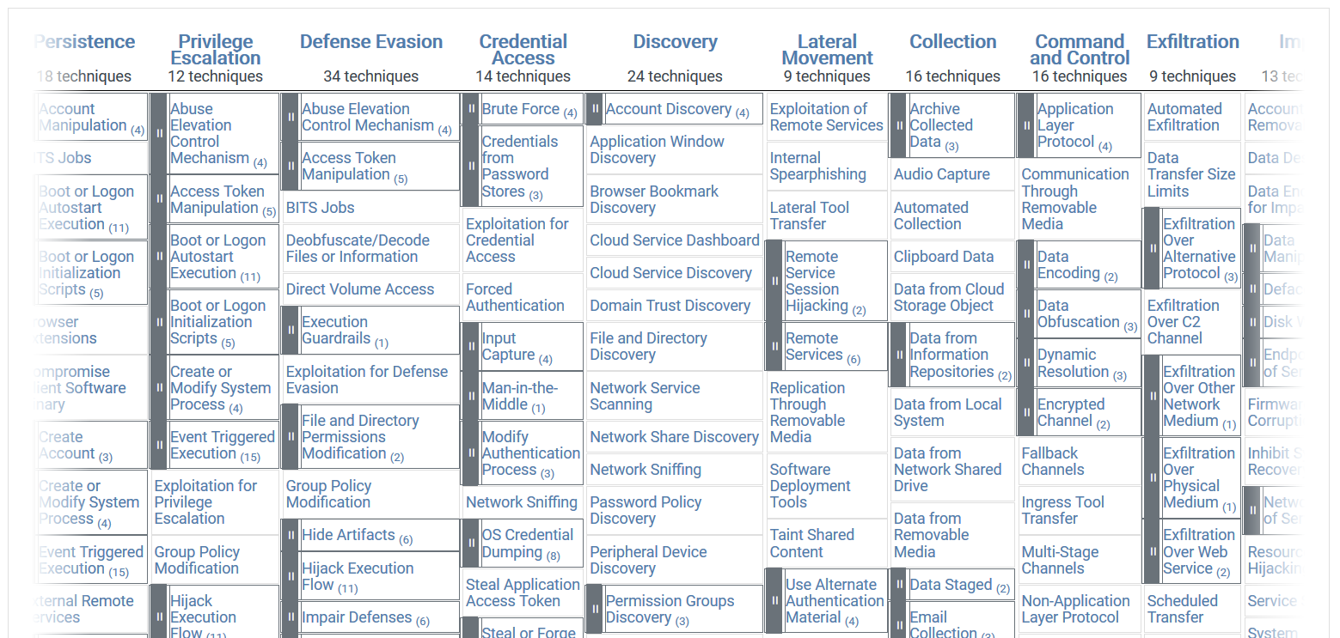
Enterprise ATT&CK Matrix
The Framework mapped out for an organization (details the Risk)
Notes:
A glimpse of the Enterprise-oriented ATT&CK Matrix (which is what I used to conduct the research)

Slide 9
Elements of the MITRE ATT&CK® Framework
12 Tactics - represent the adversary’s tactical goal: the reason for performing an action.
266 Techniques - represent “how” an adversary achieves a tactical goal by performing an action.
41 Mitigations – represent the actions, settings, countermeasures taken to prevent successful exploitation of an adversary’s tactics and/or techniques.
Notes:
Summary of the elements of the Enterprise ATT&CK Matrix.
ATT&CK consists of 266 documented TECHNIQUES that adversaries use to accomplish one of twelve activities that are typical of the behaviors of attackers. MITRE calls these activities “TACTICS”, and they identify 12 broad categories of tactics. There are currently 41 MITIGATIONS listed to address each of the tactics/techniques.

Slide 10
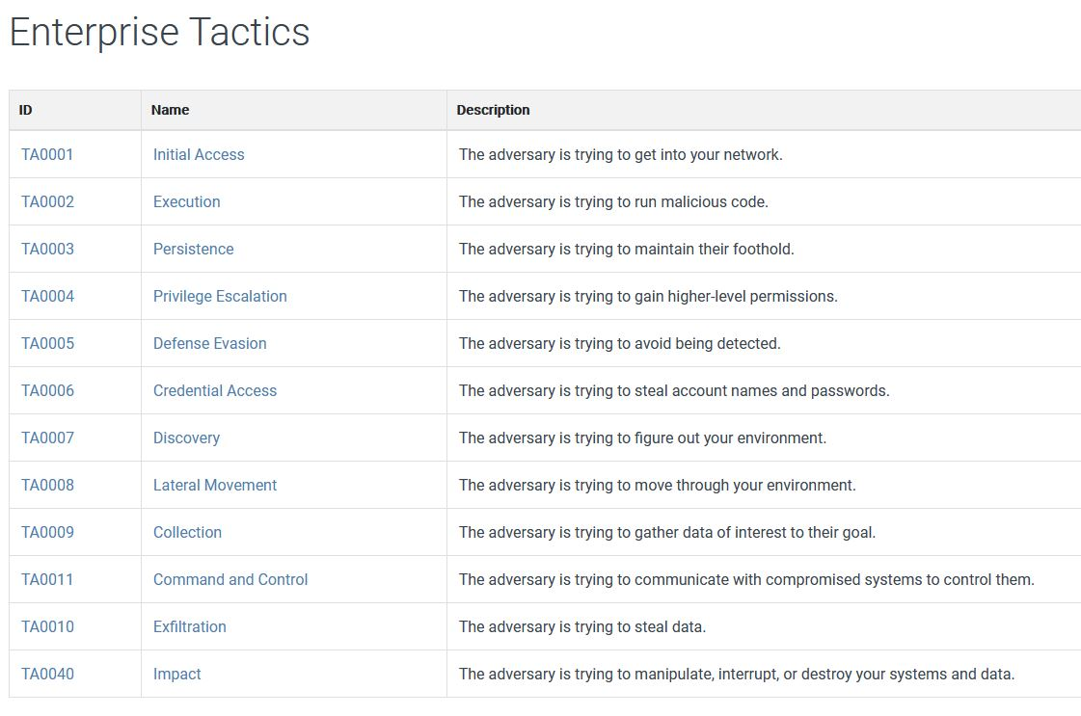
Enterprise Tactics
The goals of the ATT&CK (the Threat)
Notes:
A list of the 12 tactics (or goals) that adversaries will attempt to accomplish during a breach.

Slide 11
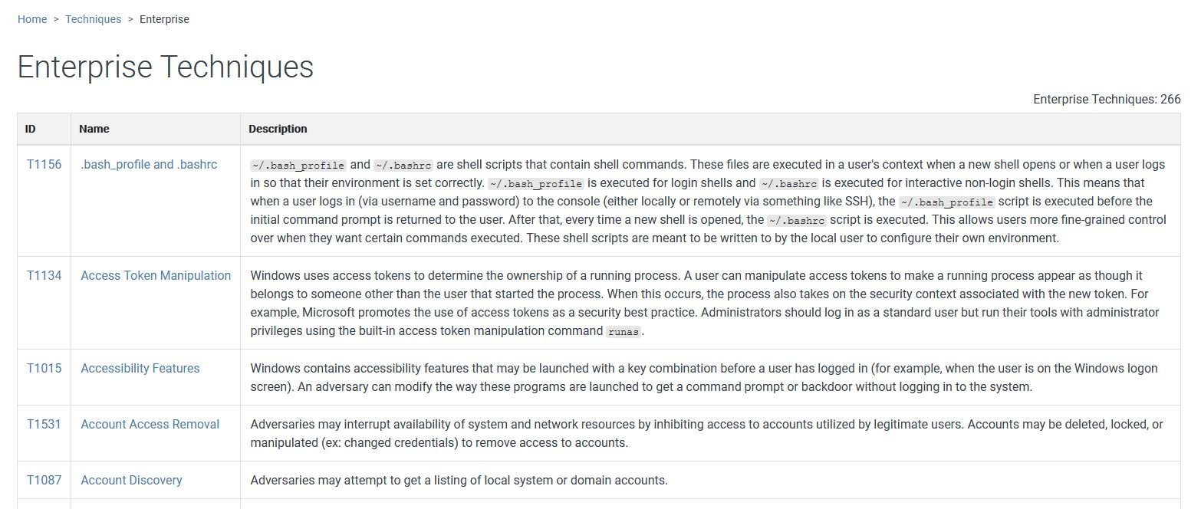
Enterprise Techniques
How the ATT&CK achieves the tactical goal (exploit Vulnerabilities)
Notes:
The meat of ATT&CK are the documented attack TECHNIQUES. These are derived from forensic analyses of real-world incidents, activities of Advanced Persistent Threats (APTs), and other documented sources.
MITRE currently includes 266 techniques in the ATT&CK framework.
The key aspect of these attack techniques is that they are reflective of what’s really happening “in the wild” – not just hypothetical or theoretical attacks.

Slide 12
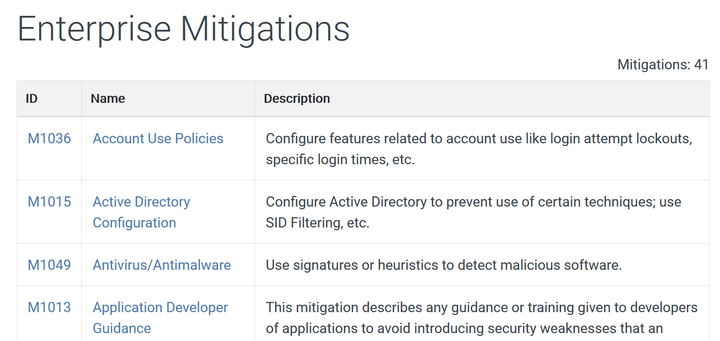
Enterprise Mitigations
How to prevent the ATT&CK techniques (Countermeasures)
Notes:
For every technique included in the ATT&CK framework there are mitigations (how to prevent, fix, and/or detect the attack technique). MITRE currently lists 41 total mitigations
One thing to note is that some mitigations help to satisfy or address multiple attack techniques.

Slide 13
Mapping ATT&CK to PCI DSS
Notes:
On to the research. I have often seen mappings of the PCI DSS to newer regulatory standards, best practice standards, frameworks, etc. (e.g. the NIST CSF or RMF, NIST 800-53, CIS Top 20 Controls) but…
What I wanted to do was see how well ATT&CK actually mapped to PCI DSS.
My hypothesis is base on this rationale: no matter how you use ATT&CK in your operations, whatever deficiencies are identified in your program, you will want to perform the recommended mitigation(s) so as not to be vulnerability to exploitation in this manner. moving forward.

Slide 14
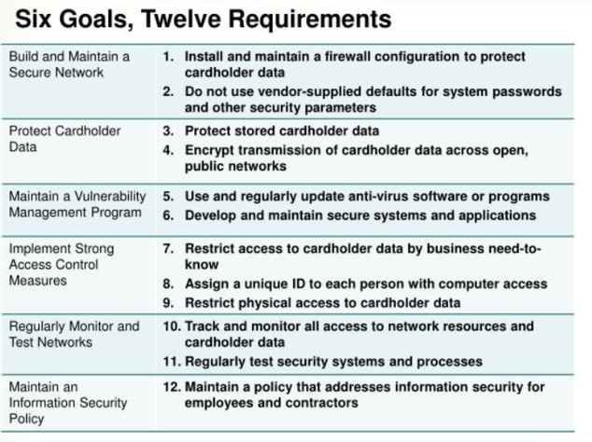
PCI Data Security Standard
Notes:
I want to emphasize that PCI DSS itself is a security framework, and that even though it’s going on 16 years old, at a macro level it still represents the major components or best practices of a cybersecurity program that any organization can follow.

Slide 15
Apparent applicability to PCI DSS
11.3 Penetration Testing
11.3.1 external
11.3.2 internal
12.2 Risk Assessment
12.2.b annual review
12.10 Incident Response
12.10.2 review and test the plan
Notes:
From the brief introduction to ATT&CK and/or whatever you already knew about it, you might guess that ATT&CK would most likely be used as part of activities to support these PCI requirements.
Real attack techniques applied to penetration testing methodologies is a no-brainer
Applying these techniques, or for example emulating the techniques used by a particular hacking group (APT) would make an outstanding table-top type of risk assessment exercise
Testing or gauging the response capabilities (automated and manual) of your security programs will help make the team better and determine the efficacy of tools already employed. (e.g. do they work?)

Slide 16
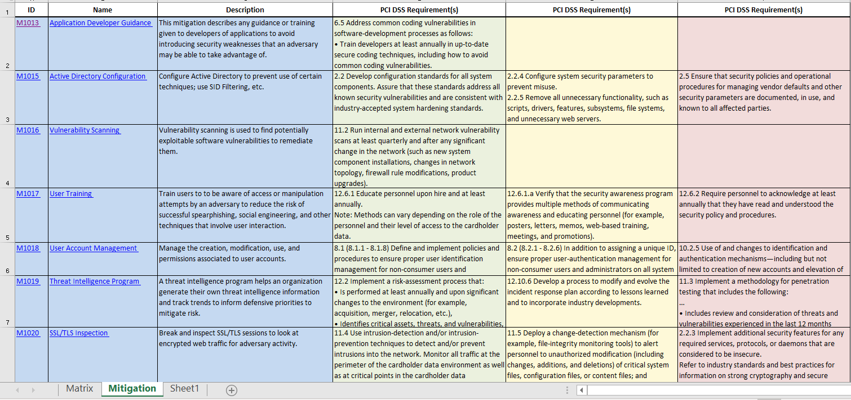
Mapping the Mitigations to PCI DSS Requirements
Notes:
Explanation of the research I conducted. Listing all 41 mitigations (effectively 40 mitigatons) and then identifying the PCI DSS requirement(s) that address each of the mitigation activities. I limited myself to three layers of abstraction for this exercise, but in some cases there may have been more applicable requirements.

Slide 17
Findings & Observations
Notes:
So, what did I find out? The results were not surprising from one perspective but extremely eye opening from another…

Slide 18
Explanation of Mappings
EXPLICIT
One for one
Straightforward
22 out of 41
IMPLICIT
Covered
Not spelled out
Need deeper knowledge of the DSS
NEED TO SQUINT
13 out of 41
Not explicitly covered
Different viewpoint
Assumptions needed
DO NOT MITIGATE
Recommended action might increase risk of compromise
1 out of 41
5 out of 41
Notes:
As I read through the mitigations I started to realize that some were very straightforward because the mitigation was verbatim an existing PCI DSS requirement. I call these “explicit” mappings. I also found that there were several mitigations that, while I firmly believe they are addressed by the PCI DSS, it was not so straightforward – some knowledge of security in general, the nature of the mitigation, and particularly an understanding of the activities and intent of the PCI DSS requirements is necessary to make the correlation. I called these “implicit” mappings. Finally, there were certain mitigations that I felt one could argue might be found in the PCI DSS requirements, but for varying reasons would be some level of “stretch” to make the correlation. I called these the “need to squint” mappings. Finally, there is one mitigation which is “do nothing – the fix is more dangerous than the problem” – I simply did not map that one.

Slide 19
Explicit Mappings (Examples)
M1016 - Vulnerability Scanning
M1027 - Password Policies
M1042 - Disable or Remove Feature or Program
M1049 - Antivirus/Anti-malware
M1051 – Update Software
Notes:
Some examples of explicit mappings of ATT&CK to PCI DSS requirements.

Slide 20
Implicit Mappings (Examples)
M1015 – Active Directory Configuration
M1024 – Restrict Registry Permissions
M1030 – Network Segmentation
M1047 – Audit
M1050 – Exploit Protection
Notes:
M1047 – Audit - Perform audits or scans of systems, permissions, insecure software, insecure configurations, etc. to identify potential weaknesses.
Some examples of implicit mappings of ATT&CK to PCI DSS requirements.

Slide 21
Need to Squint
M1020 – SSL/TLS Inspection
M1044 – Restrict Library Loading
M1045 – Code Signing
M1046 – Boot Integrity
M1048 – Application Isolation and Sandboxing
Notes:
The full list of “need to squint” mappings of ATT&CK to PCI DSS requirements.

Slide 22
Mitigations Mapped to PCI DSS
1
5
22
13
Notes:
Graphical representation of my results

Slide 23
Observations
The vast majority of mitigations map to PCI DSS (35/41)
Some are not straightforward – you need to know how to apply the PCI DSS
Which validates the use of ATT&CK®
There were several specific PCI DSS requirements that were identified as addressing or helping to address the particular mitigation in question
Suggest an alternative (or validated) criteria for prioritization of PCI DSS requirements (Prioritize Approach to PCI)
Gives QSAs and ISAs justification for requiring better adherence to certain requirements
Notes:
Details of my findings and some initial calculation of statistics

Slide 24
Top 5 PCI DSS Requirements
Requirement | Description
2.2 | Develop configuration standards for all system components
8.x | Identify and authenticate access to system components
6.4 | Follow change control processes and procedures for all changes to system components
11.5 | Deploy a change-detection mechanism
6.3 | Secure software development
Notes:
The top 5 PCI DSS requirements that showed up in my mapping to ATT&CK mitigations.
Any surprises???
Note was didn’t make the list –patch management, vulnerability scanning, penetration testing…
6 – Req. 7.1 Limit access to system components

Slide 25
Req. 2.2 “Develop Configuration Standards”
30% of mitigations (12/40) are addressed by PCI DSS 2.2 (Develop configuration standards for all system components) and its sub-requirements
You need to know what systems you are using
You need to follow security best practices
ATT&CK® can help you justify/validate this process
These 12 Mitigations relate back to 92 ATT&CK® Techniques
Meaning 34.5% of attacks are addressed by just one major PCI DSS requirement
Based on Mitigations in ATT&CK® the most important PCI DSS requirement is 2.2
Notes:
This to me was the most significant finding, and where I want to get on my soapbox for a moment.
I have allowed some very “weak” and “vague” configuration/hardening standards over the years and based on discussion with my fellow QSAs that would appear to be the norm. Generally the standards I review say something to the effect of “our configuration standard is based on the <respective> CIS Benchmark” and more or less implies “we just follow the benchmark/best practice rather than rewrite it on our own letterhead”.
What this misses is the opportunity to customize and tailor the hardening and configuration best practices to what makes sense for your particular business environment. My hope is that these findings – that indicate that over 1/3 of REAL WORLD attacks can be prevented or mitigated by focusing more efforts into this one, single PCI DSS requirement.

Slide 26

Contact Information
Mr. Jeffrey E. Man
InfoSec Evangelist
InfoSec Curmudgeon
Tribe of Hackers
Online Business Systems
jman@obsglobal.com
@MrJeffMan
301-310-4275
Notes:
Feel free to reach out to me with any InfoSec related questions.

Slide 27

Notes:
Ordinarily Q&A – but also a life lesson ☺

